Slide 1
"From Startup to Success: Our Journey of 3000% Growth in 5 Years"

Slide 2
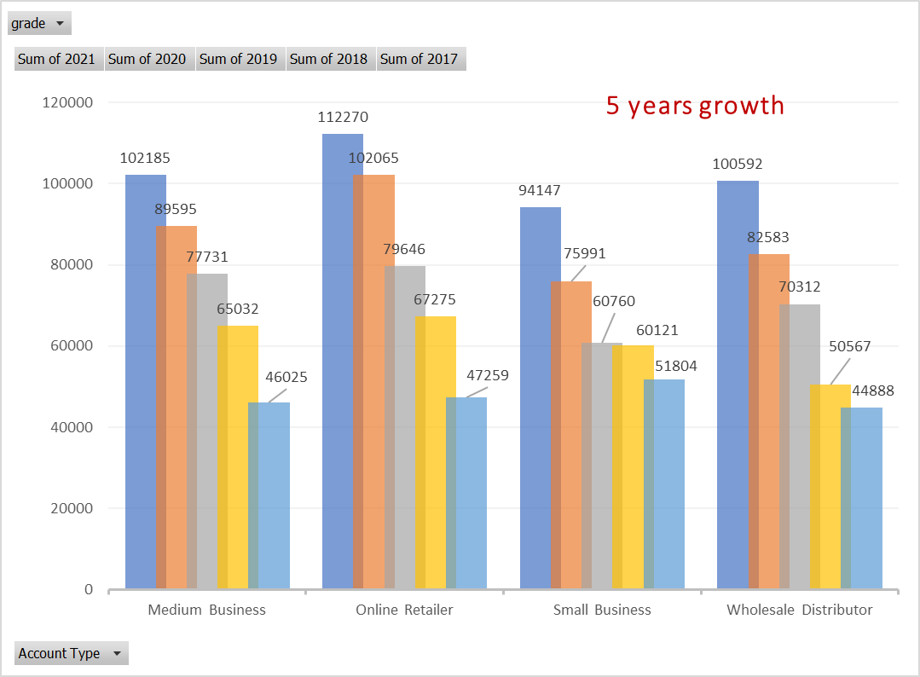
Power of growth through Innovation and Strategy."
We grew by 3000% in 5 years and growing at 28%
Consistent YoY growth:
Consistent and continuous growth.

Slide 3
Our Business
Best business segments: Medium Business and Online Retailers.
Cross-selling: 87% of products are cross-sold.
Positive impact of Social Media and Promotions: never resulted in negative growth in any year.

Slide 4
Overall, our unit sales growth has been good, with a 5-year CAGR of 21%.…

Slide 5
Our People
Top decision maker: Tim Young has been our best decision maker with a CAGR over 300%.
High-performing decision makers: 18% of decision-makers are generating over 100% CAGR.
Positive growth: 55% of decision-makers are making positive growth.

Slide 6
Summary
Harness the power of social media to increase brand awareness, engagement, and sales. Introduce innovative promotions to attract new customers.
Offer Customized Solutions to meet the unique needs of our customers
Data analysis to continuously improve our products and services and identify new opportunities for growth.
Plateauing Growth at 28%
Cross-Selling: To boost revenue.
Negative Revenue by 26% of decision-makers, support them by upskilling opportunities and incentivizing.
Focus on Wholesale Distributors and Small Businesses, by introducing innovative promotional strategies to increase their sales.

